Slide 1
Channel Capacity

Slide 2
Channel Capacity
The maximum rate at which data can be transmitted over a given communication path, or channel, under given conditions, is referred to as the channel capacity.
There are four concepts here that we are trying to relate to one another.
Data rate : The rate, in bits per second (bps), at which data can be communicated
Bandwidth: The bandwidth of the transmitted signal as constrained by the transmitter and the nature of the transmission medium, expressed in cycles per second, or Hertz
Noise : The average level of noise over the communications path
Error rate : The rate at which errors occur, where an error is the reception of a1 when a 0 was transmitted or the reception of a 0 when a 1 was transmitted
Two theoretical models: (Calculate Data rate)
Nyquist Capacity : noise-free environment or Noiseless channel
Shannon Capacity : Noisy Channel

Slide 3
Nyquist Bandwidth
Channel that is noise free
Given a bandwidth of B, the highest signal rate is 2B
Single signal element may carry more than 1 bit; signal with M levels may carry log₂ M bits
C = 2B log₂M
Tradeoffs:
Increase the bandwidth, increases the data rate.
Increase the signal levels, increases the data rate.
Increase the signal levels, harder for receiver to interpret the bits (practical limit to M)

Slide 4
A noiseless channel has a bandwidth of 4000 Hz and is transmitting a signal with two signal levels. Calculate the maximum bit rate
B=4000Hz
M=2
C = 2B log₂M
Bit Rate = 2 * 4000 * log₂2
= 2 * 4000 * 1
=8000 bps

Slide 5
A noiseless channel has a bandwidth of 4000 Hz and is transmitting a signal with two signal with four signal levels. Calculate the maximum bit rate
B=4000Hz
M=4
C = 2B log₂M
Bit Rate = 2 * 4000 * log₂4
= 2 * 4000 * 2
=16000 bps

Slide 6
Consider a noiseless channel with a bandwidth of 20 KHz. We need to send 280 Kbps over a channel. How many signal levels are required?
C =280 Kbps
B = 20 KHz
C = 2B log₂M Log _{a} x = y
280 = 2 * 20 * log₂ M x = a^{y}
280/40 = log₂ M
7 = log₂ M
M = 2⁷
M = 128

Slide 7
Shannon Capacity
With noise, some bits may be corrupted;
higher data rate, more bits corrupted
Increasing signal strength overcomes noise
› Signal-to-noise ratio:
signalpower
SNR =
noisepower
High SNR➔ high-quality signal ➔ less intermediate repeaters
Shannon capacity: C = B log₂ (1 + SNR)
Tradeoffs:
Increase bandwidth or signal power, increases data rate
Increase of noise, reduces data rate
Increase bandwidth, allows more noise

Slide 8
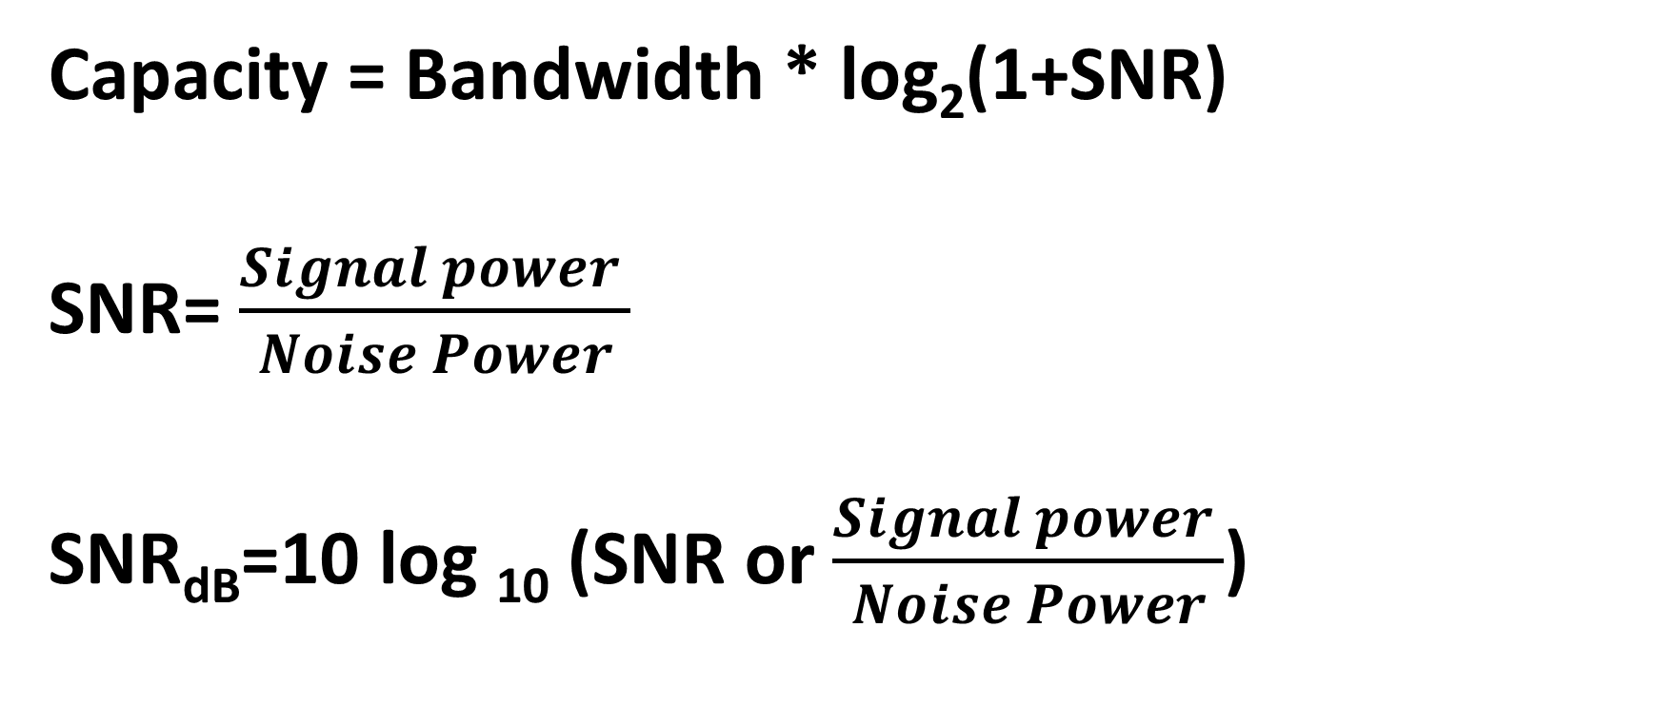
Shannon Capacity : Noisy channel
Capacity = Bandwidth * log₂(1+SNR)
SNR= $\frac{Signal power }{Noise Power}$
SNR_{dB}=10 log ₁₀ (SNR or $\frac{Signal power }{Noise Power}$)

Slide 9
Example of Shannon and Nyquist Capacity
A channel uses spectrum of between 3MHz and 4MHz, with SNR_{dB} = 24dB. How many signal levels are required to achieve Shannon capacity?
OR
Let us consider an example that relates the Nyquist and Shannon formulations. Suppose that the spectrum of a channel is between 3 MHz and 4 MHz and SNR_{dB} = 24 dB. Then

Slide 10
Solution
B = 4 MHz - 3 MHz = 1 MHz
SNR_{dB} = 24 dB = 10 log ₁₀(SNR)
SNR = 251
Using Shannon’s formula,
C = 10⁶ * log ₂ (1+251)
= 10⁶ * 8
= 8 Mbps
Nyquist formula,
B= 10⁶ Hz
C = 8 Mbps
C = 2B log₂M Log _{a} x = y
8 * 10⁶ = 2 * 10⁶ * log₂ M x = a^{y}
4 = log₂ M
M = 16

Slide 11
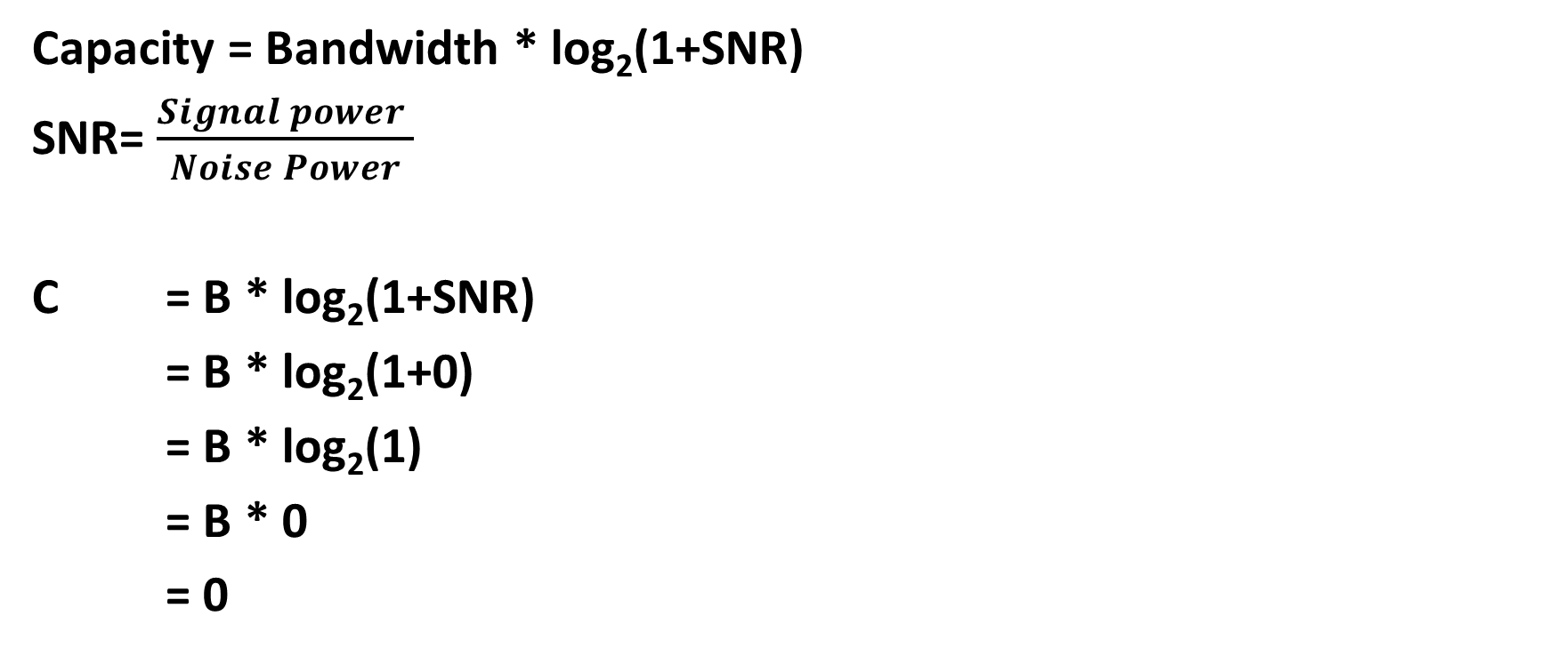
Consider a extremely noisy channel in which signal to noise ratio is almost zero. Calculate the capacity of the channel
Capacity = Bandwidth * log₂(1+SNR)
SNR= $\frac{Signal power }{Noise Power}$
C = B * log₂(1+SNR)
= B * log₂(1+0)
= B * log₂(1)
= B * 0
= 0

Slide 12
Calculate the highest bit rate(capacity of the channel) if the bandwidth is 3000 Hz and signal to noise ration(SNR) is 3162
B = 3000 Hz
SNR = 3162
C = B * log₂(1+SNR)
= 3000 * log₂(1+3162)
= 3000 * log₂(3163)
= 3000 * 11.627
= 34881 bps

Slide 13
Tutorial-1 Questions
A channel has B=4kHz and SNR =30dB. Determine maximum information rate for 128 level encoding.
We need to send 256 kbps over a noiseless channel with a bandwidth 20 KHz. How many signal levels do we need?
We have a channel with a 1 Mhz bandwidth. The SNR_db for this channel is 63db.What are the appropriate bit rate and signal level?
A telephone system with modem allows bandwidth of 3100 Hz. What is the maximum data rate? M=2

Slide 14
Tutorial-1 Question-1 Solution
1. A channel has B=4kHz and SNR =30dB. Determine maximum information rate for 128 level encoding.
B=4KHz
SNR=30db
SNR_db=10 log10(SNR)
30=10 lag10(SNR)
SNR=10^(30/10)=1000
C = B log₂ (1 + SNR)
C=4k log2(1+1000)
C=4k*9.96
C=39.8Kbps
C = 2B log₂ M
C=8k *log2(128)
C=8k*7
C=56Kbps
Nyquist capacity=56kbps
Shannon capacity=39.8kbps
Smallest of two values decide channel capacity.

Slide 15
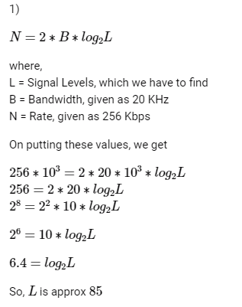
Tutorial 1 Question-2 Solution
2)We need to send 256 kbps over a noiseless channel with a bandwidth 20 KHz. How many signal levels do we need?

Slide 16
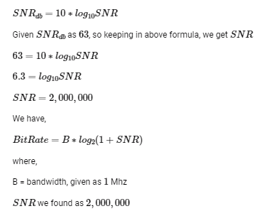
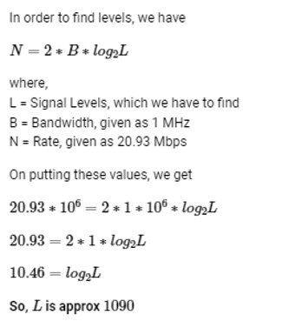
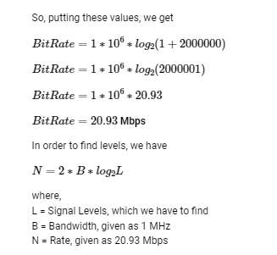
Tutorial 1 Question-3
3) We have a channel with a 1 Mhz bandwidth. The SNRdb for this channel is 63db.What are the appropriate bit rate and signal level?

Slide 17
Tutorial 1 Question-4
A telephone system with modem allows bandwidth of 3100 Hz. What is the maximum data rate? M=2
C = 2B log2M Nyquist Formula
C=2*B log2 (2)
C=2*3100*1
C=6200 bps

